Slide 1

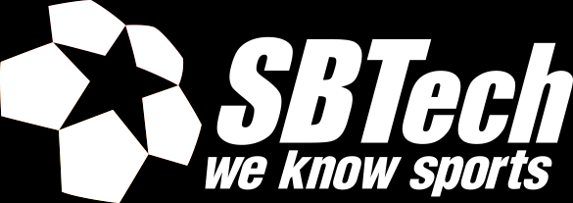
Scaling up with plug-ins
by Martin Chaov

Slide 2


Slide 3

Attention

Slide 4
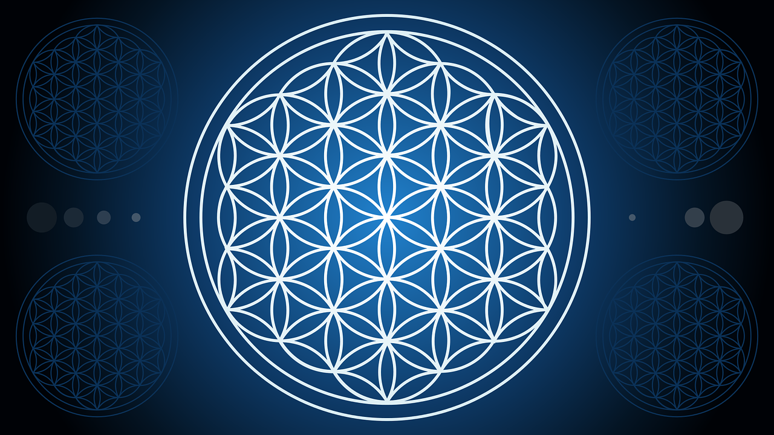
Notes:
Let’s talk about life … Application Life … Application Life Cycle to be exact…
It encompasses:
requirements management,
software architecture,
computer programming,
software testing,
software maintenance,
change management,
continuous integration,
project management,
release management.
GitLab much, TFS?
App life cycle in years and stages – how long an application is active?
How the business evolves
Change is a part of life … so how do we manage change in the software world?
With pain and suffering…

Slide 5
Plan
Develop
Test
Deploy
Maintain
Design
Notes:
A part of ALM is SDLC - software development life cycle
At what point do we take the make it or break it decisions?!
Trick question – at every phase we have such decisions…
However… there is one special place there
# Maintain
Typical life cycle of a web project of about 3-8 years on prod.
-> because programmers are bad ... code degradation
-> incompatibility between tech new/old...
-> young people don’t know old stuff… -> new tools/tech stacks

Slide 6
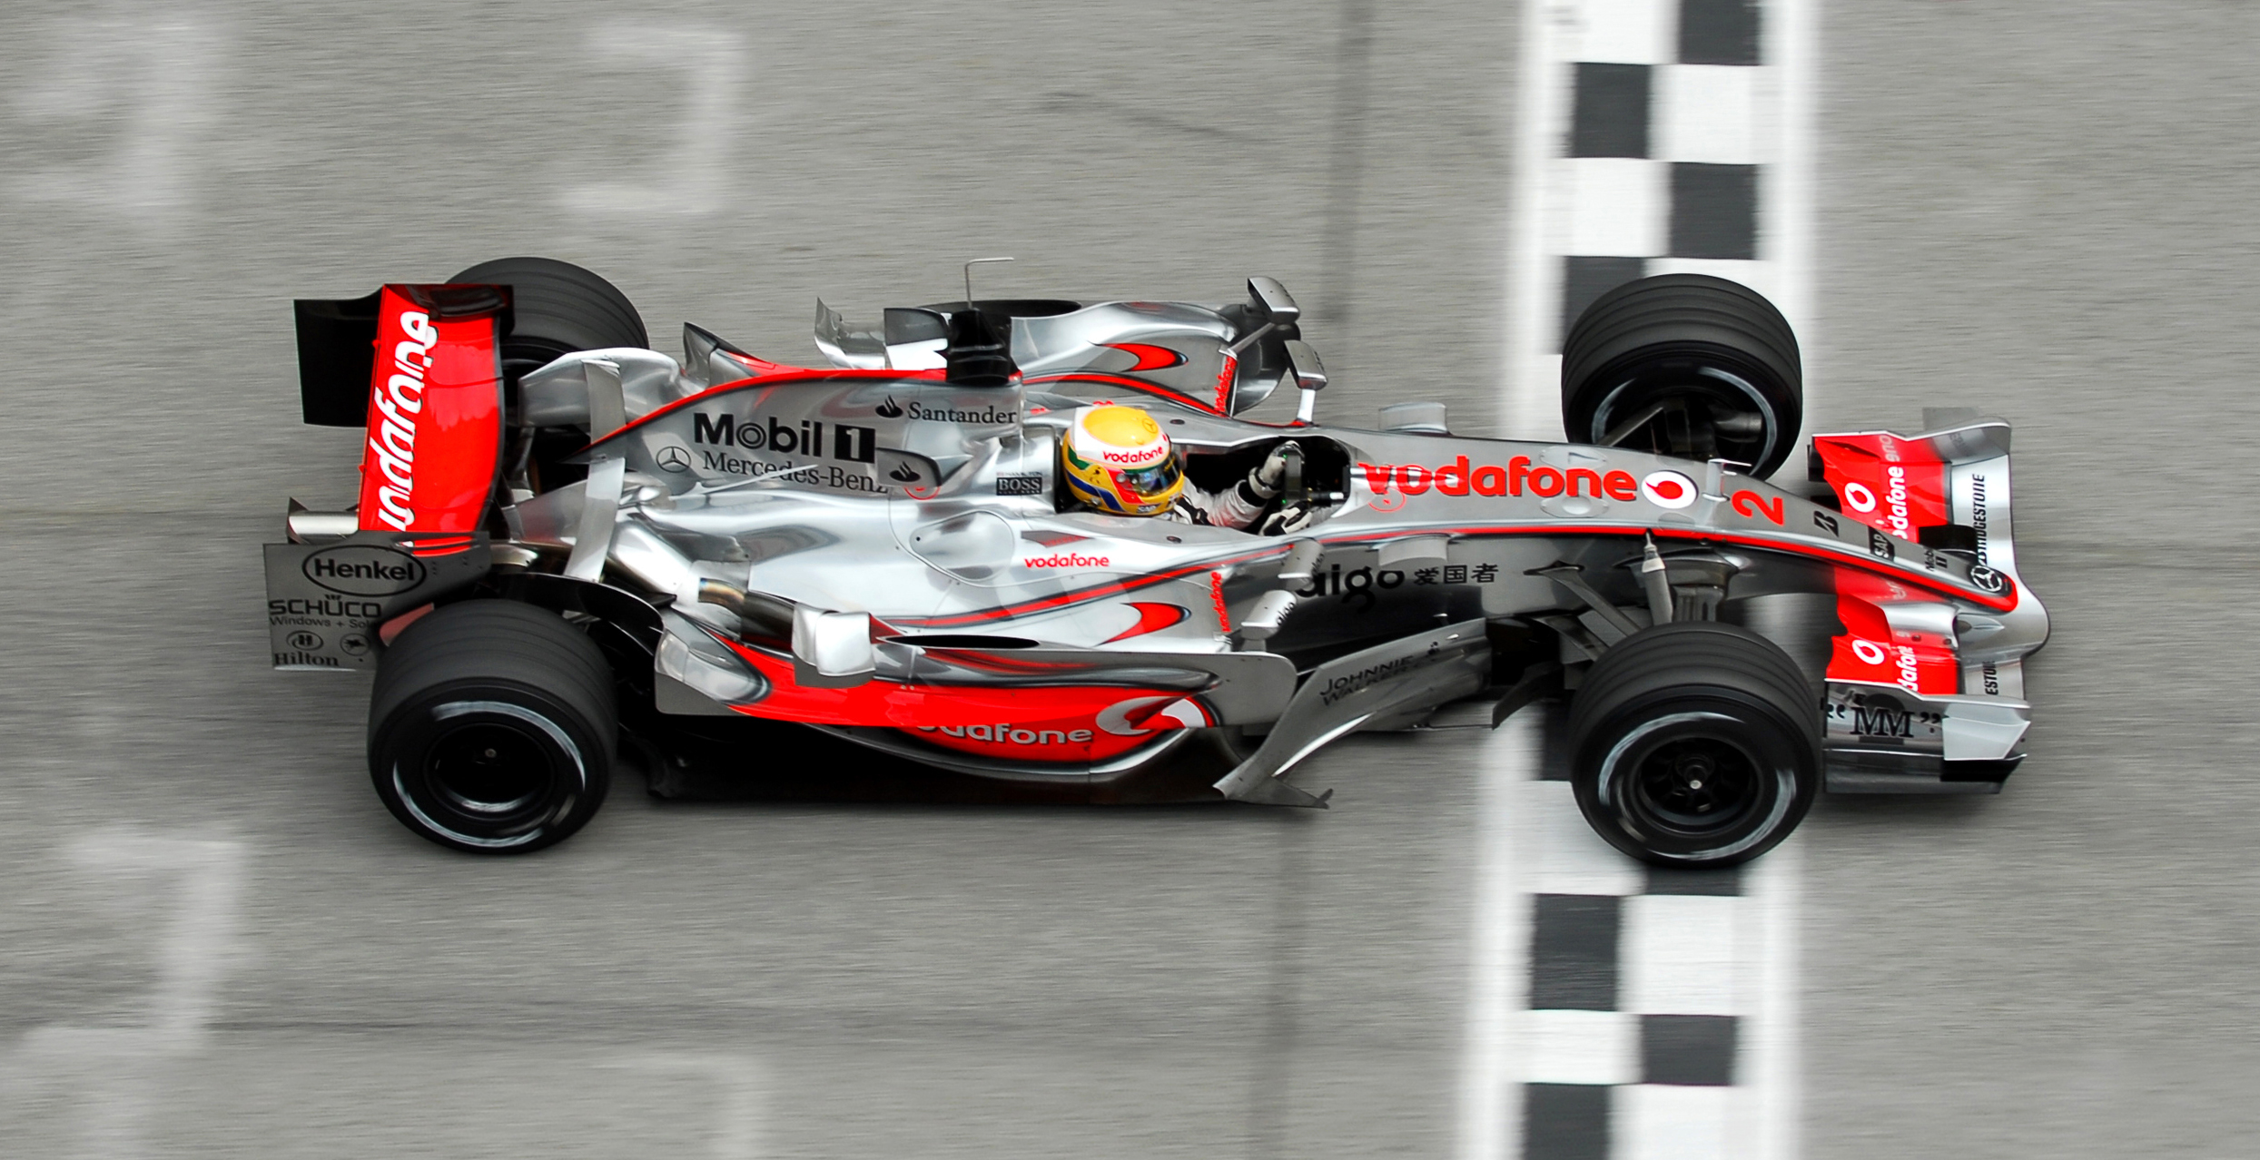
Notes:
I am solving time to market …
I need to deliver new features to the world…
How fast I can release new feature. How many systems are affected? Is restart of the system involved, can it be avoided?
Time to market includes everything from feature conceptualization until the first user adopts the features.
The first on the market doesn’t have competition
A bit of ES6 here, a bit of TypeScript there, it’ll work, trust me…

Slide 7
Plan
Develop
Test
Deploy
Maintain
Design
Notes:
In which stage we are solving TTM here?
In what way are we solving it?
Why architecture?
# Maintain
Typical life cycle of a web project of about 3-8 years on prod.
-> because programmers are bad ... code degradation
-> incompatibility between tech new/old...
-> young people don’t know old stuff… -> new tools/tech stacks

Slide 8
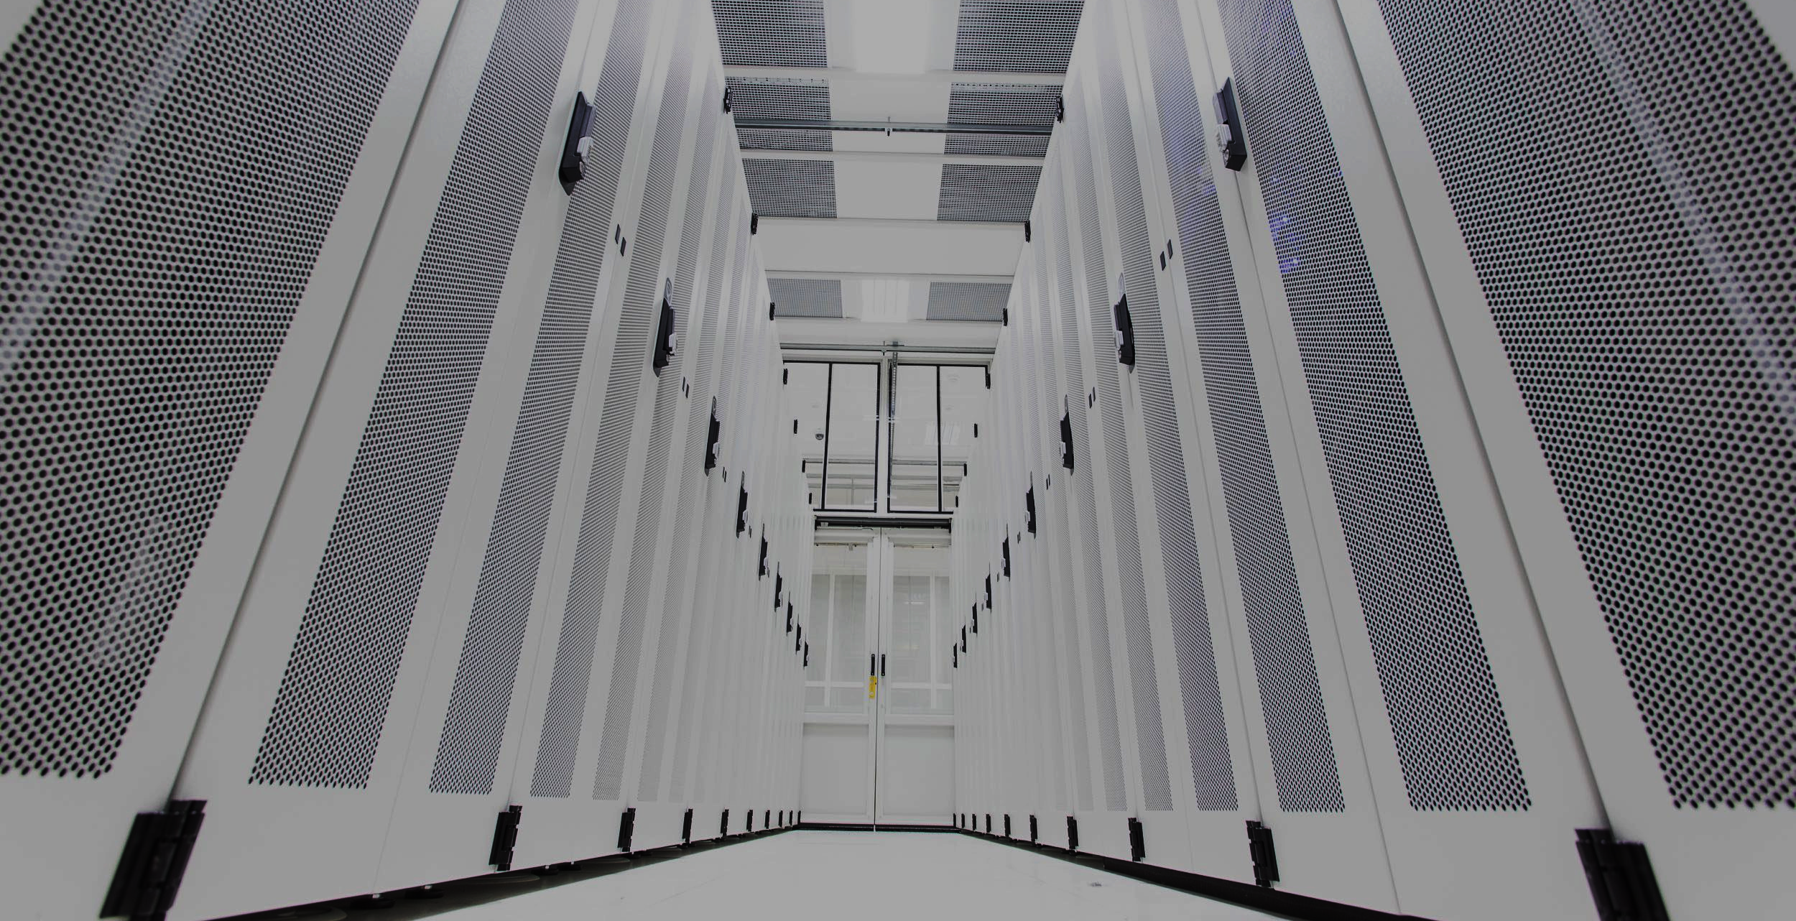
Architecture
Fundamental structural choices
Costly to change
Focus on different qualities
Notes:
Solving TTM | Arch solves business problems. R&D costs are a business requirement.
1. Software architecture is about making fundamental structural choices which are costly to change once implemented.
2. Qualities of an architecture
Performance – shows the response of the system to performing certain actions for a certain period.
Interoperability – is an attribute of the system or part of the system that is responsible for its operation and the transmission of data and its exchange with other external systems.
Usability – is one of the most important attributes, because, unlike in cases with other attributes, users can see directly how well this attribute of the system is worked out.
Reliability – is an attribute of the system responsible for the ability to continue to operate under predefined conditions.
Availability – is part of reliability and is expressed as the ratio of the available system time to the total working time.
Security – ability of the system to reduce the likelihood of malicious or accidental actions as well as the possibility of theft or loss of information.
Maintainability –ability of the system to support changes.
Modifiability – determines how many common changes need to be made to the system to make changes to each individual item.
Testability – how well the system allows performing tests, according to predefined criteria.
Scalability – handle load increases without decreasing performance, or the possibility to rapidly increase the load.
Reusability – chance of using a component or system in other components/systems with small or no change.
Supportability – useful information for identifying and solving problems.

Slide 9
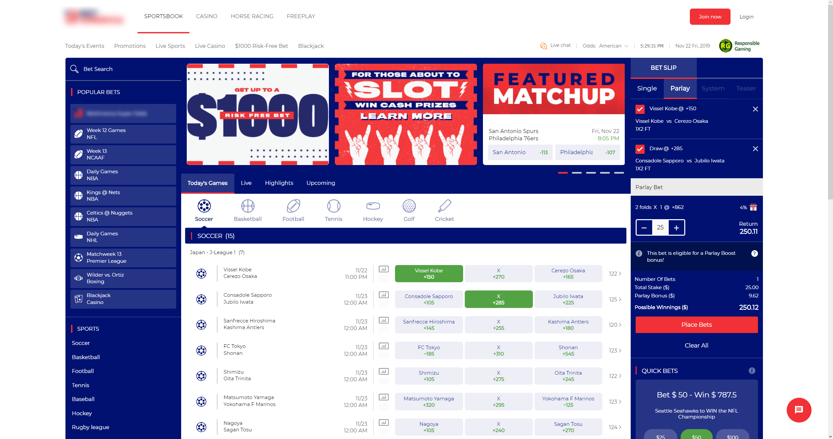
Notes:
Some call it web site … I call it 10 years of my life …
Let’s think about plugins for my … web application
But first … what is a plugin?

Slide 10

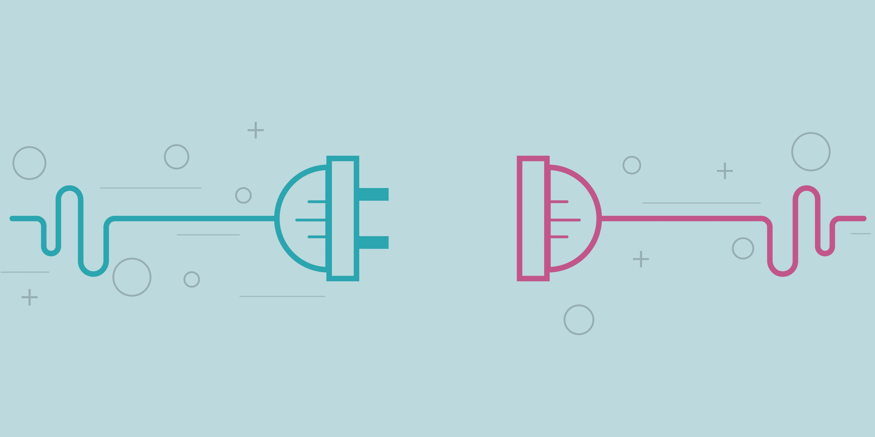
What is a Plug-in?
A piece of software – a component
Extend or enhance existing functionality
Add new features
Can not live on it’s own
Notes:
Software component that adds a specific feature to an existing computer program.
- A piece of software - a component
- Extends or enhances existing features
- Adds new features
- Can not live on it's own
Do you remember the time when you needed to reboot your PC to add/remove connected devices?
What is the best plug-in system you know?
In order to get a plug-in we need to have a system. System with clear contract for communication between the components. Let's call them interfaces :)
Let's examine an example interface...

Slide 11
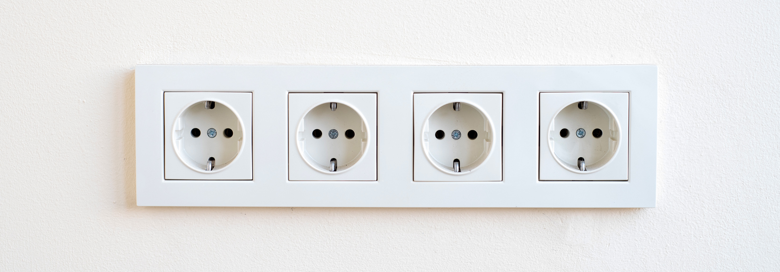
An interface
CEE 7/5 socket
CEE 7/6 plug
230V AC
50 Hz

Slide 12
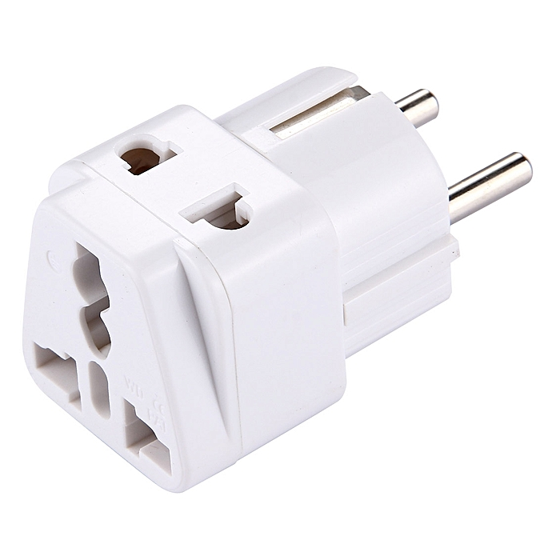
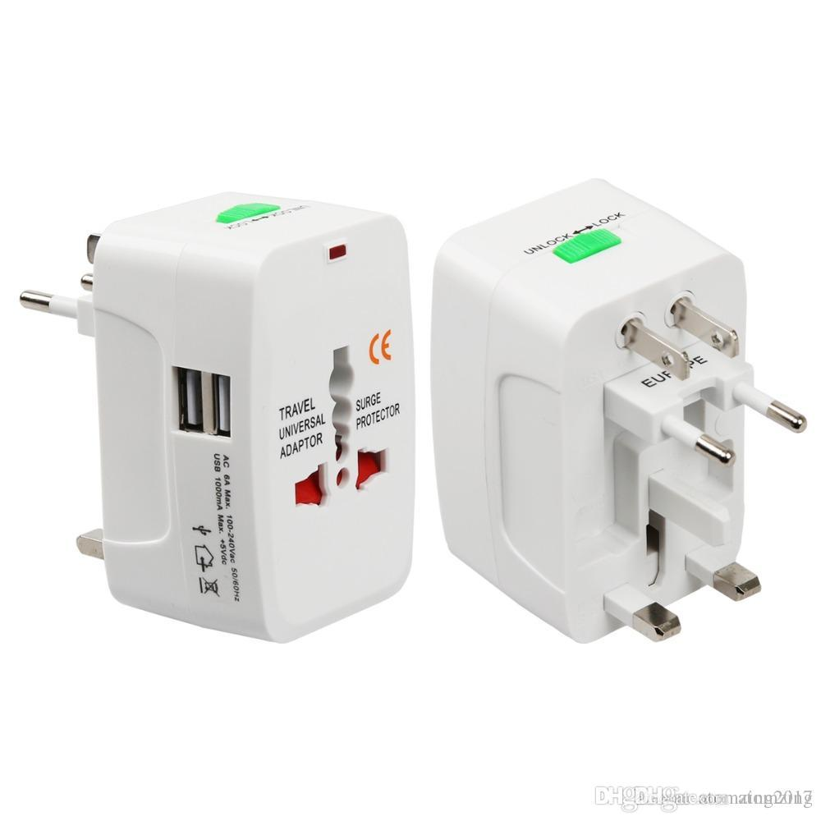
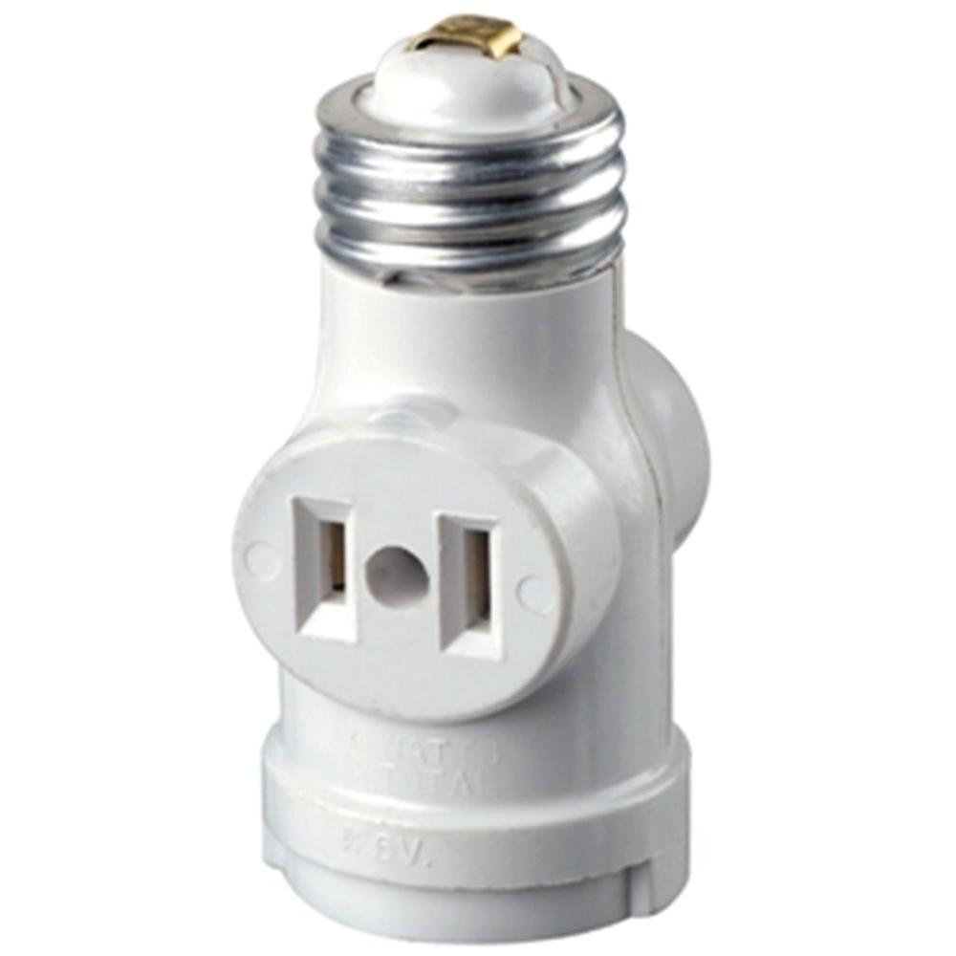

Slide 13
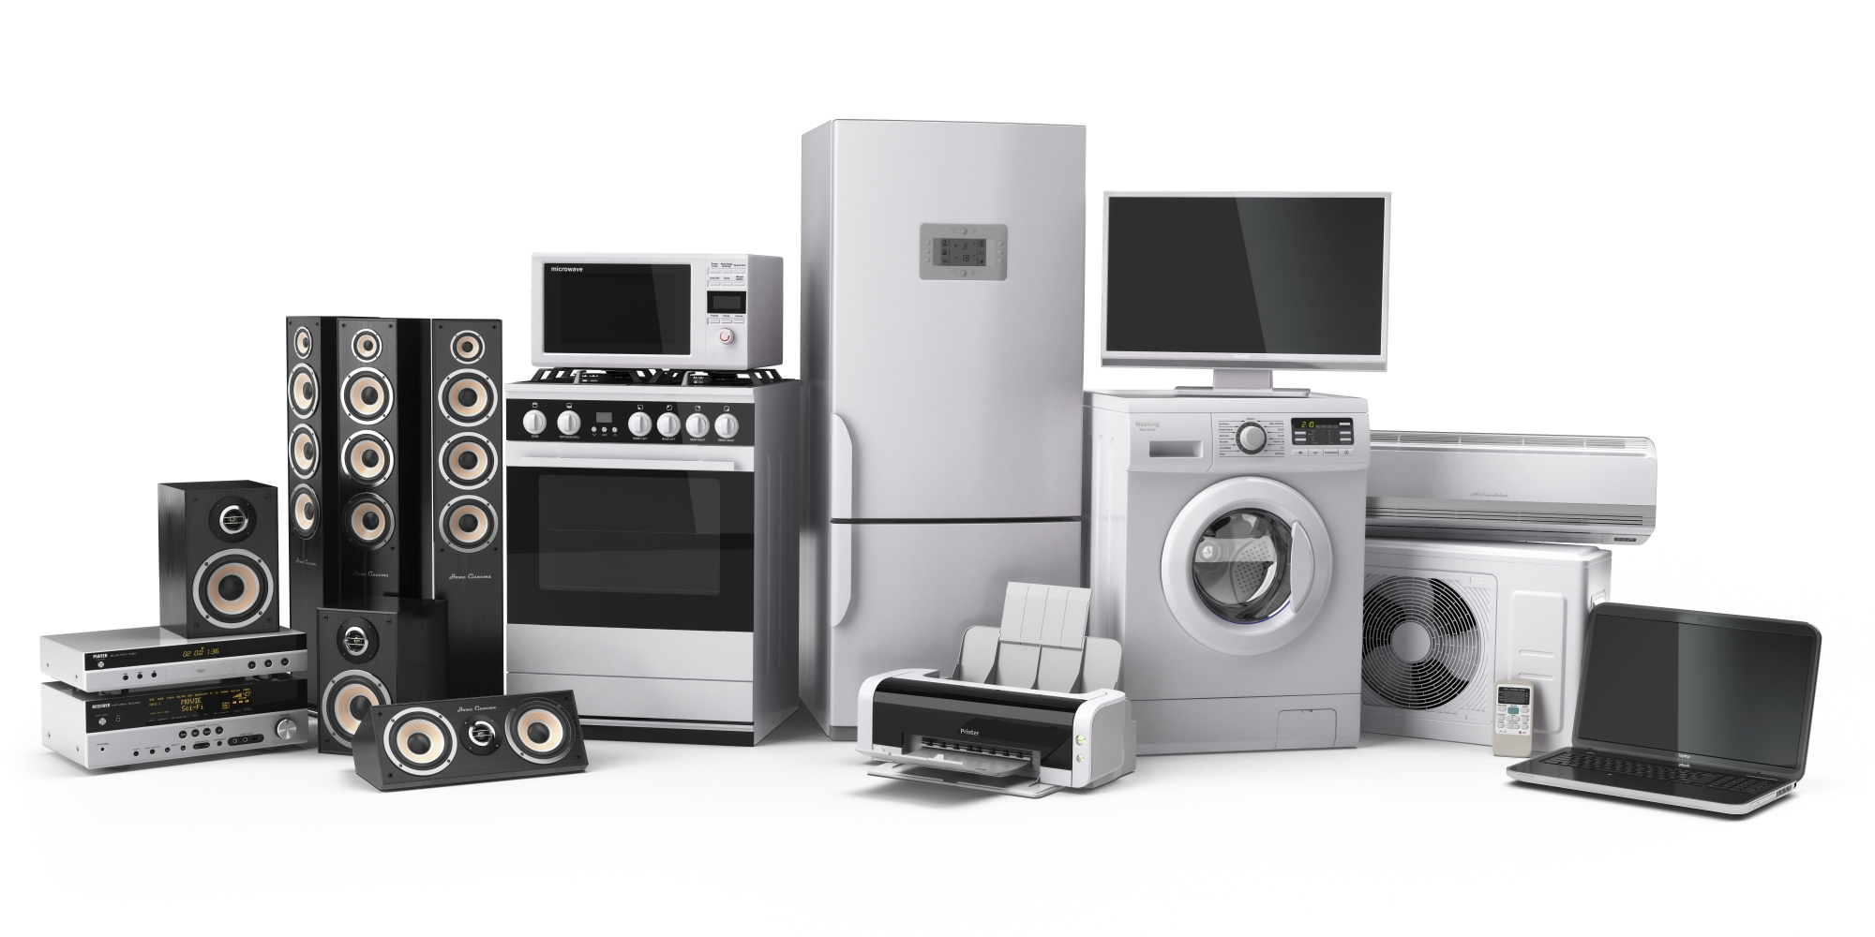

Slide 14
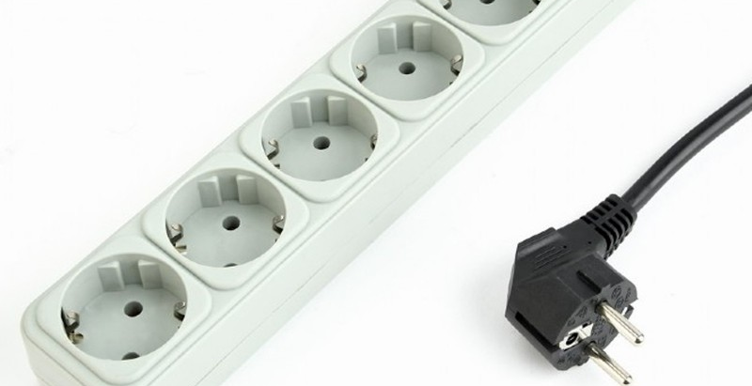

Slide 15

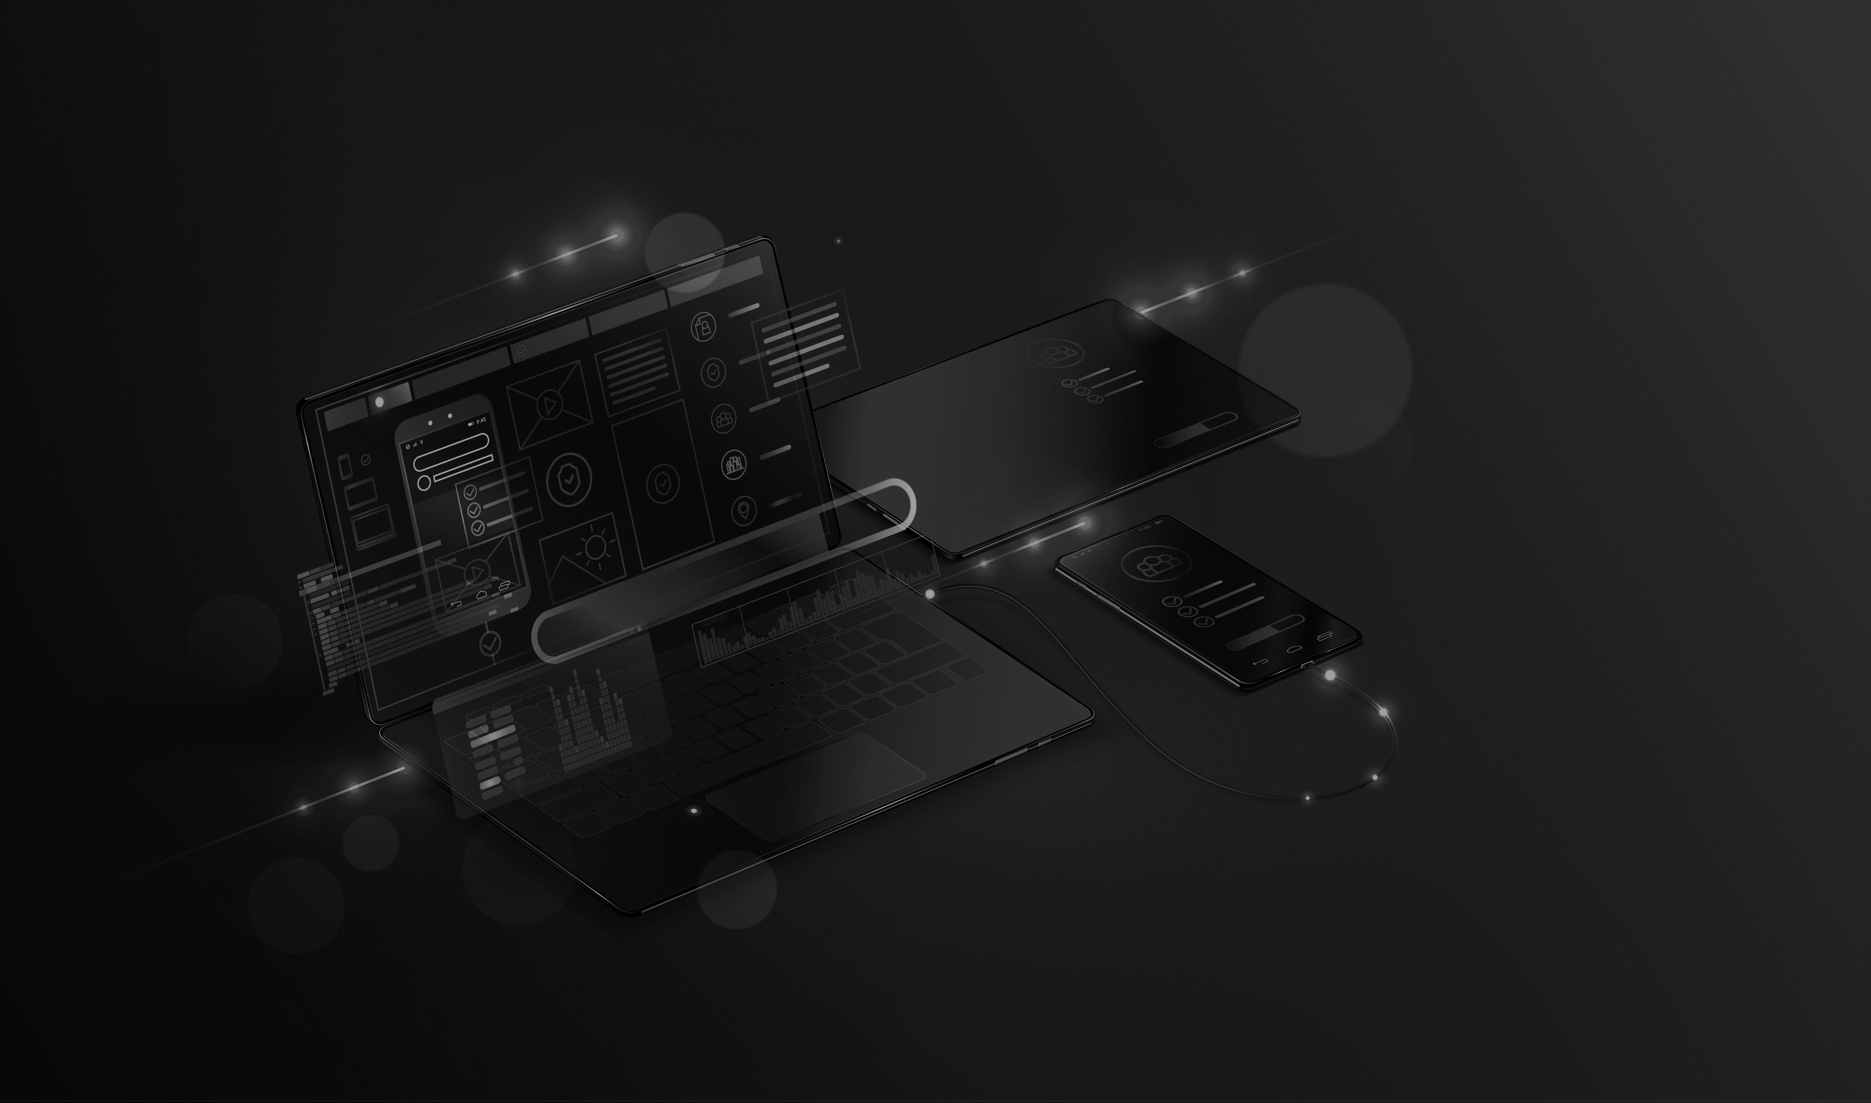

…back to software…
Notes:
When a program supports plug-ins, it enables customization…

Slide 16
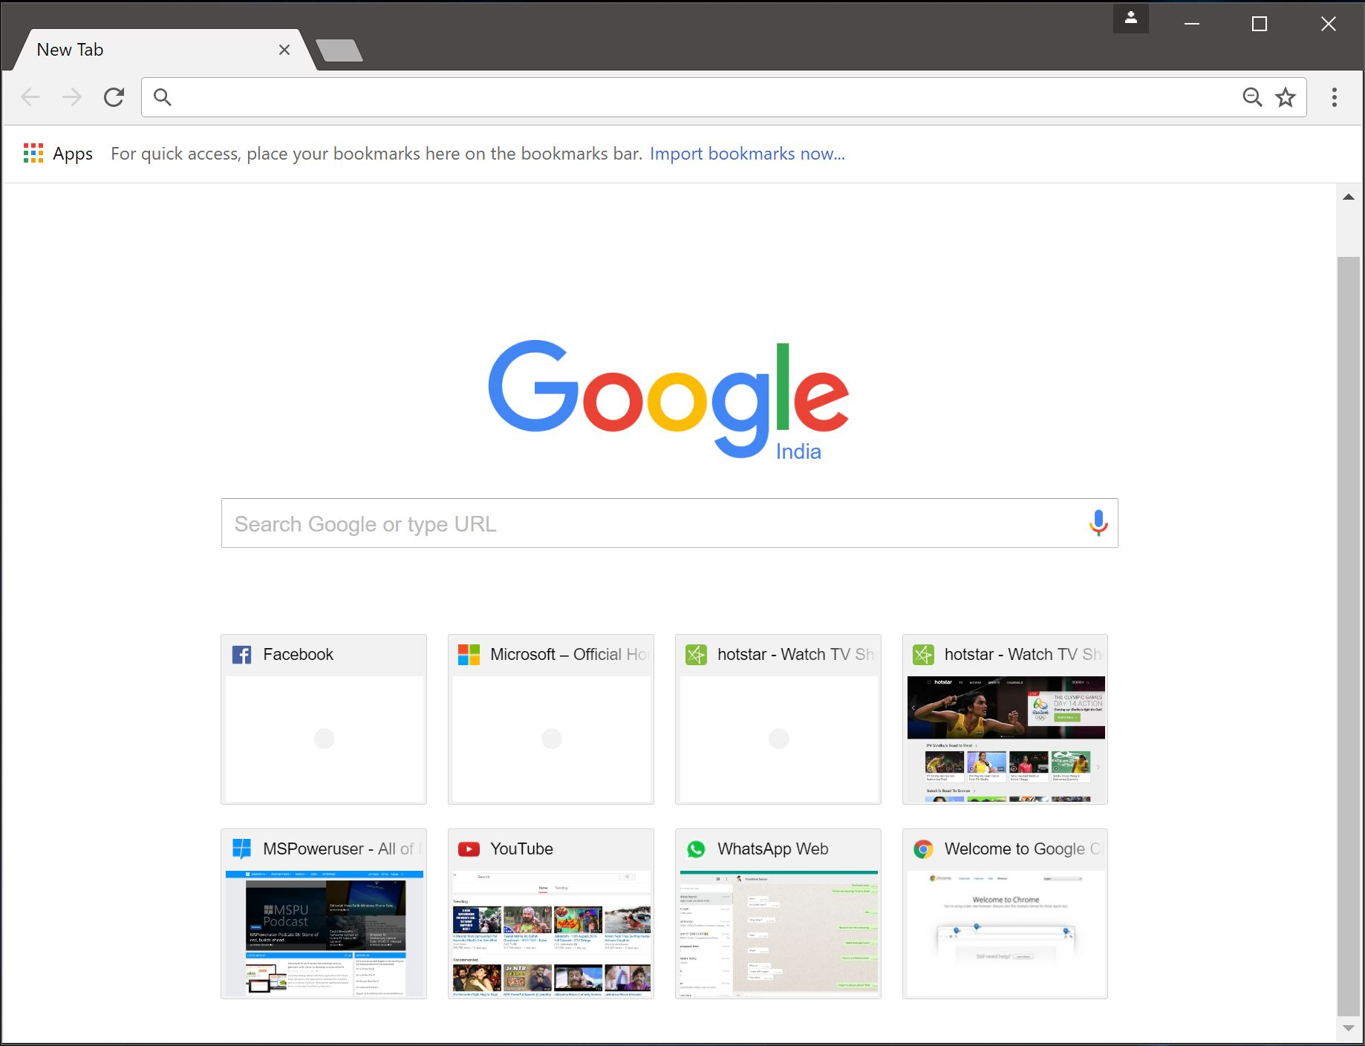
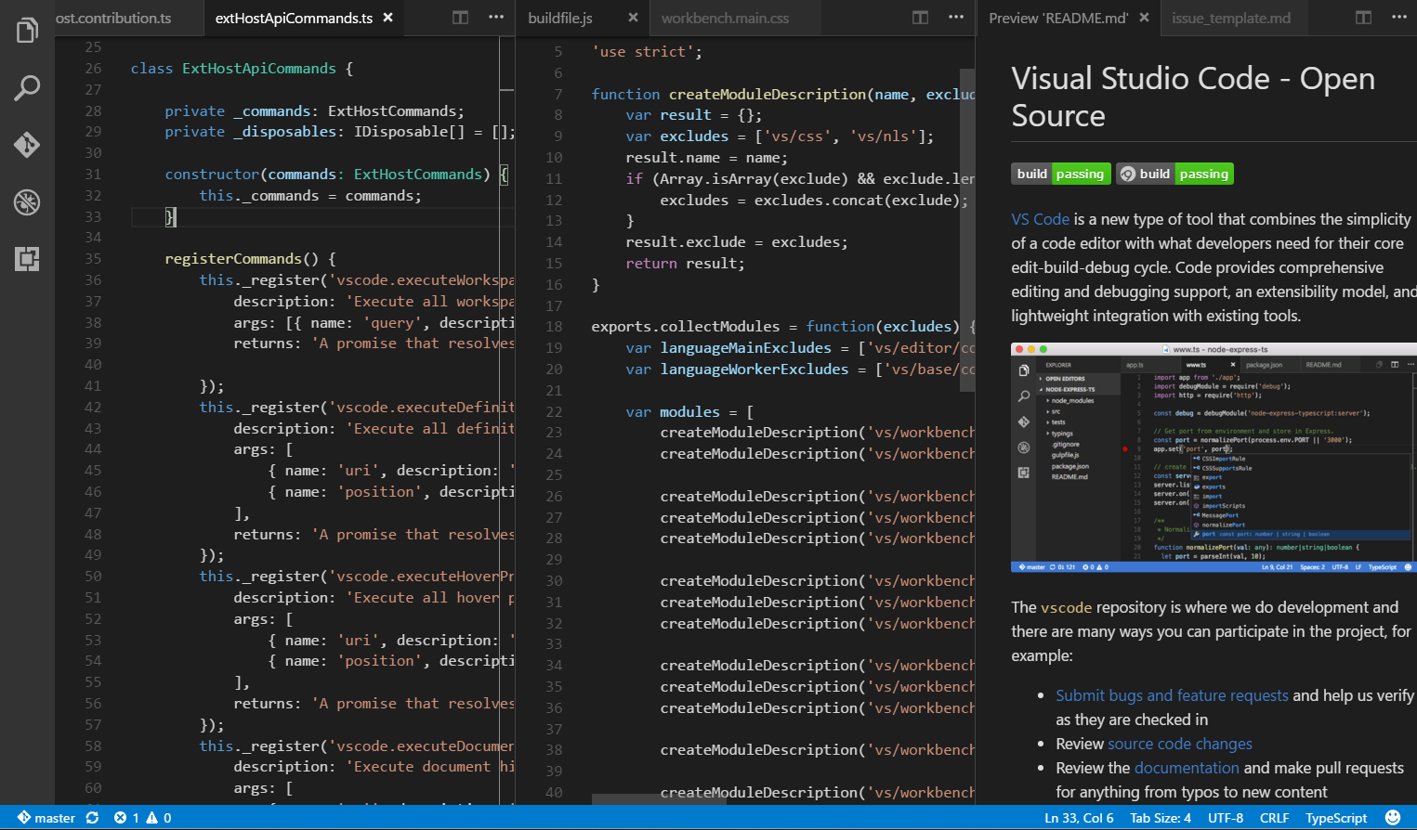
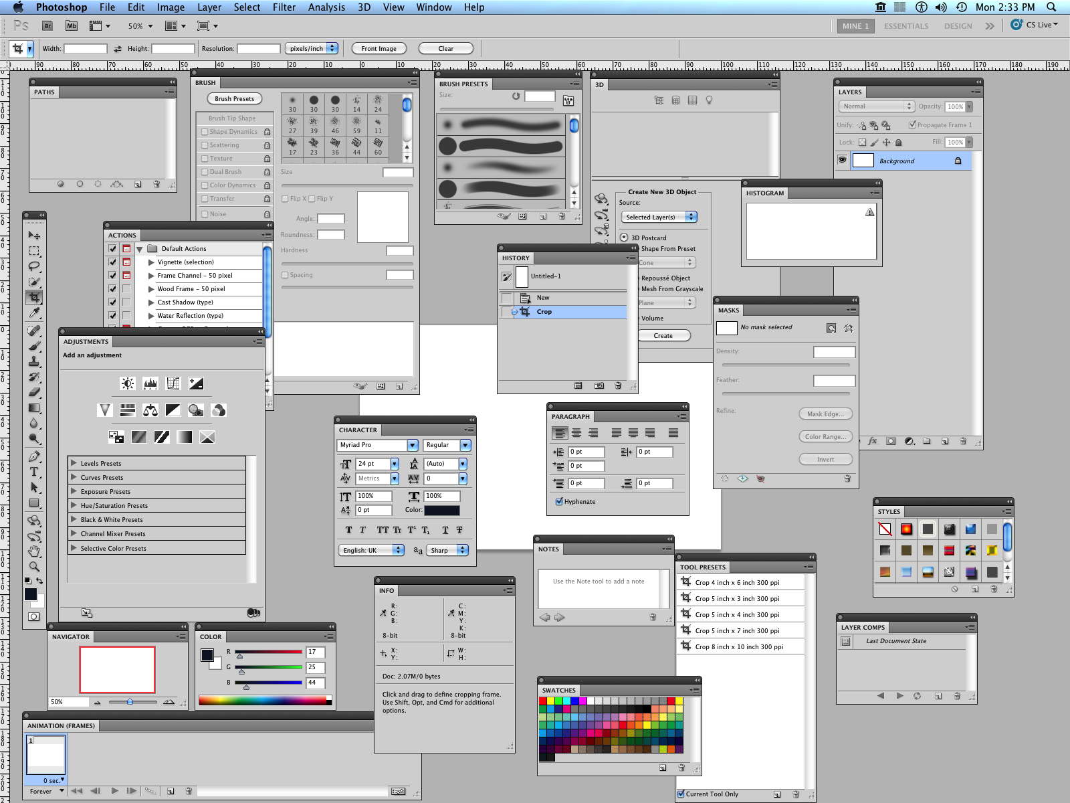
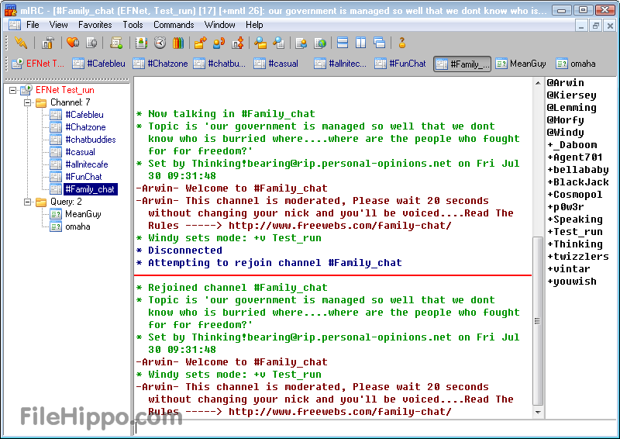
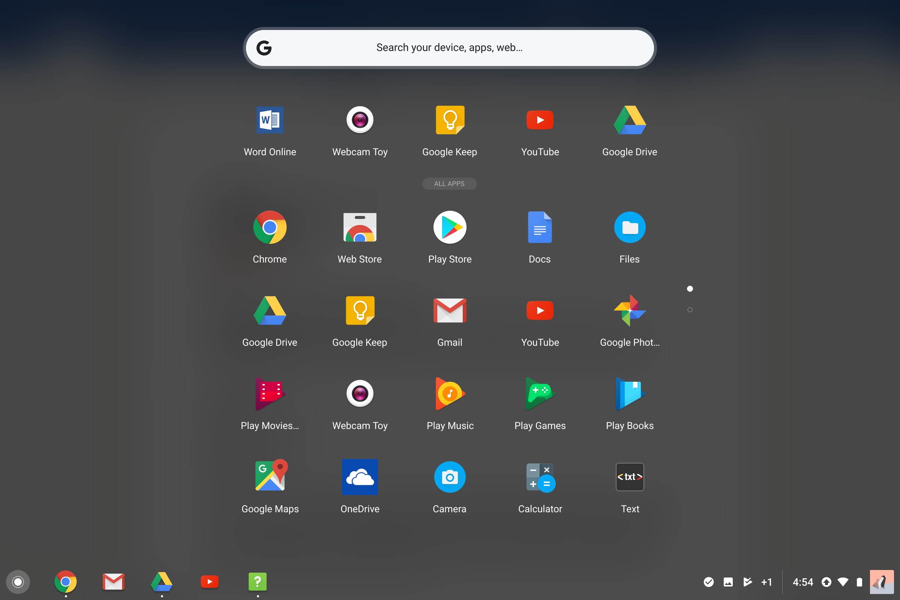
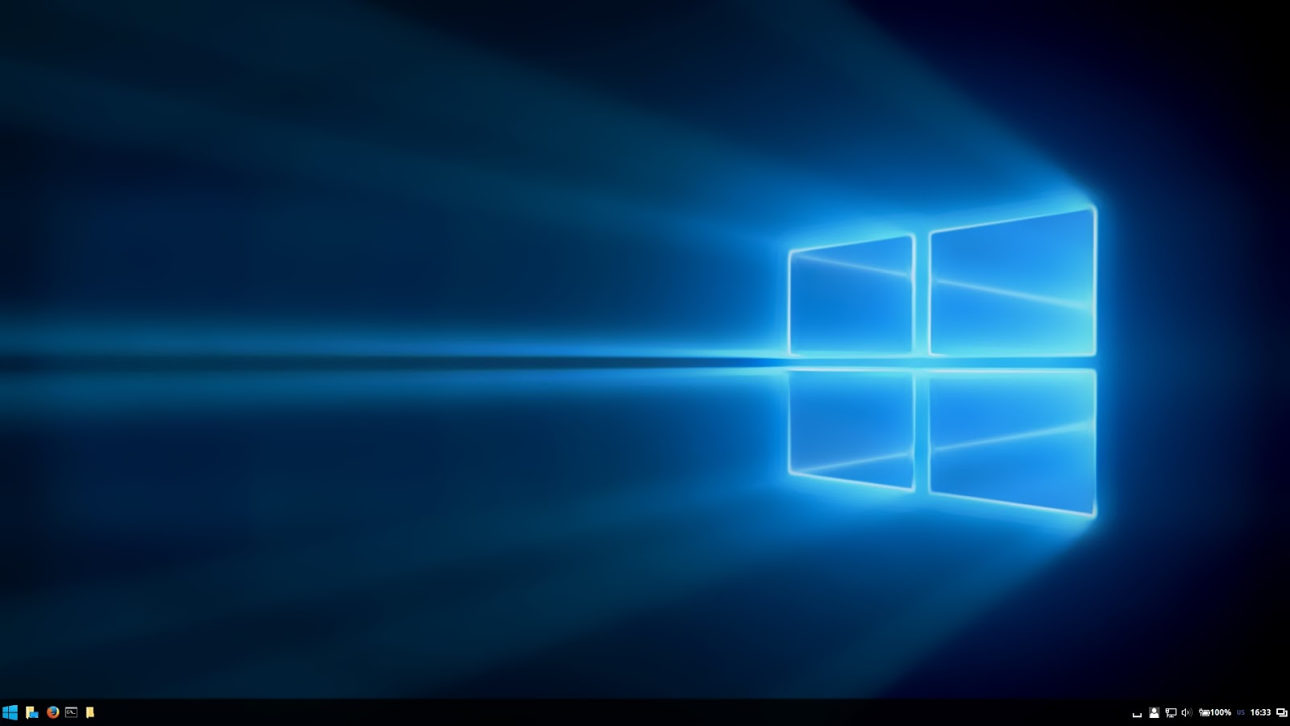
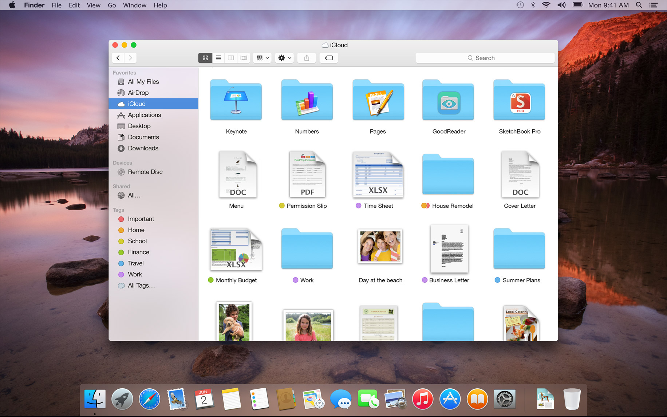
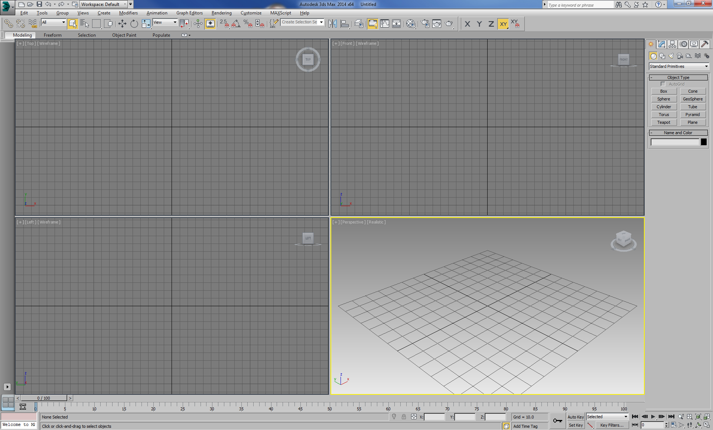
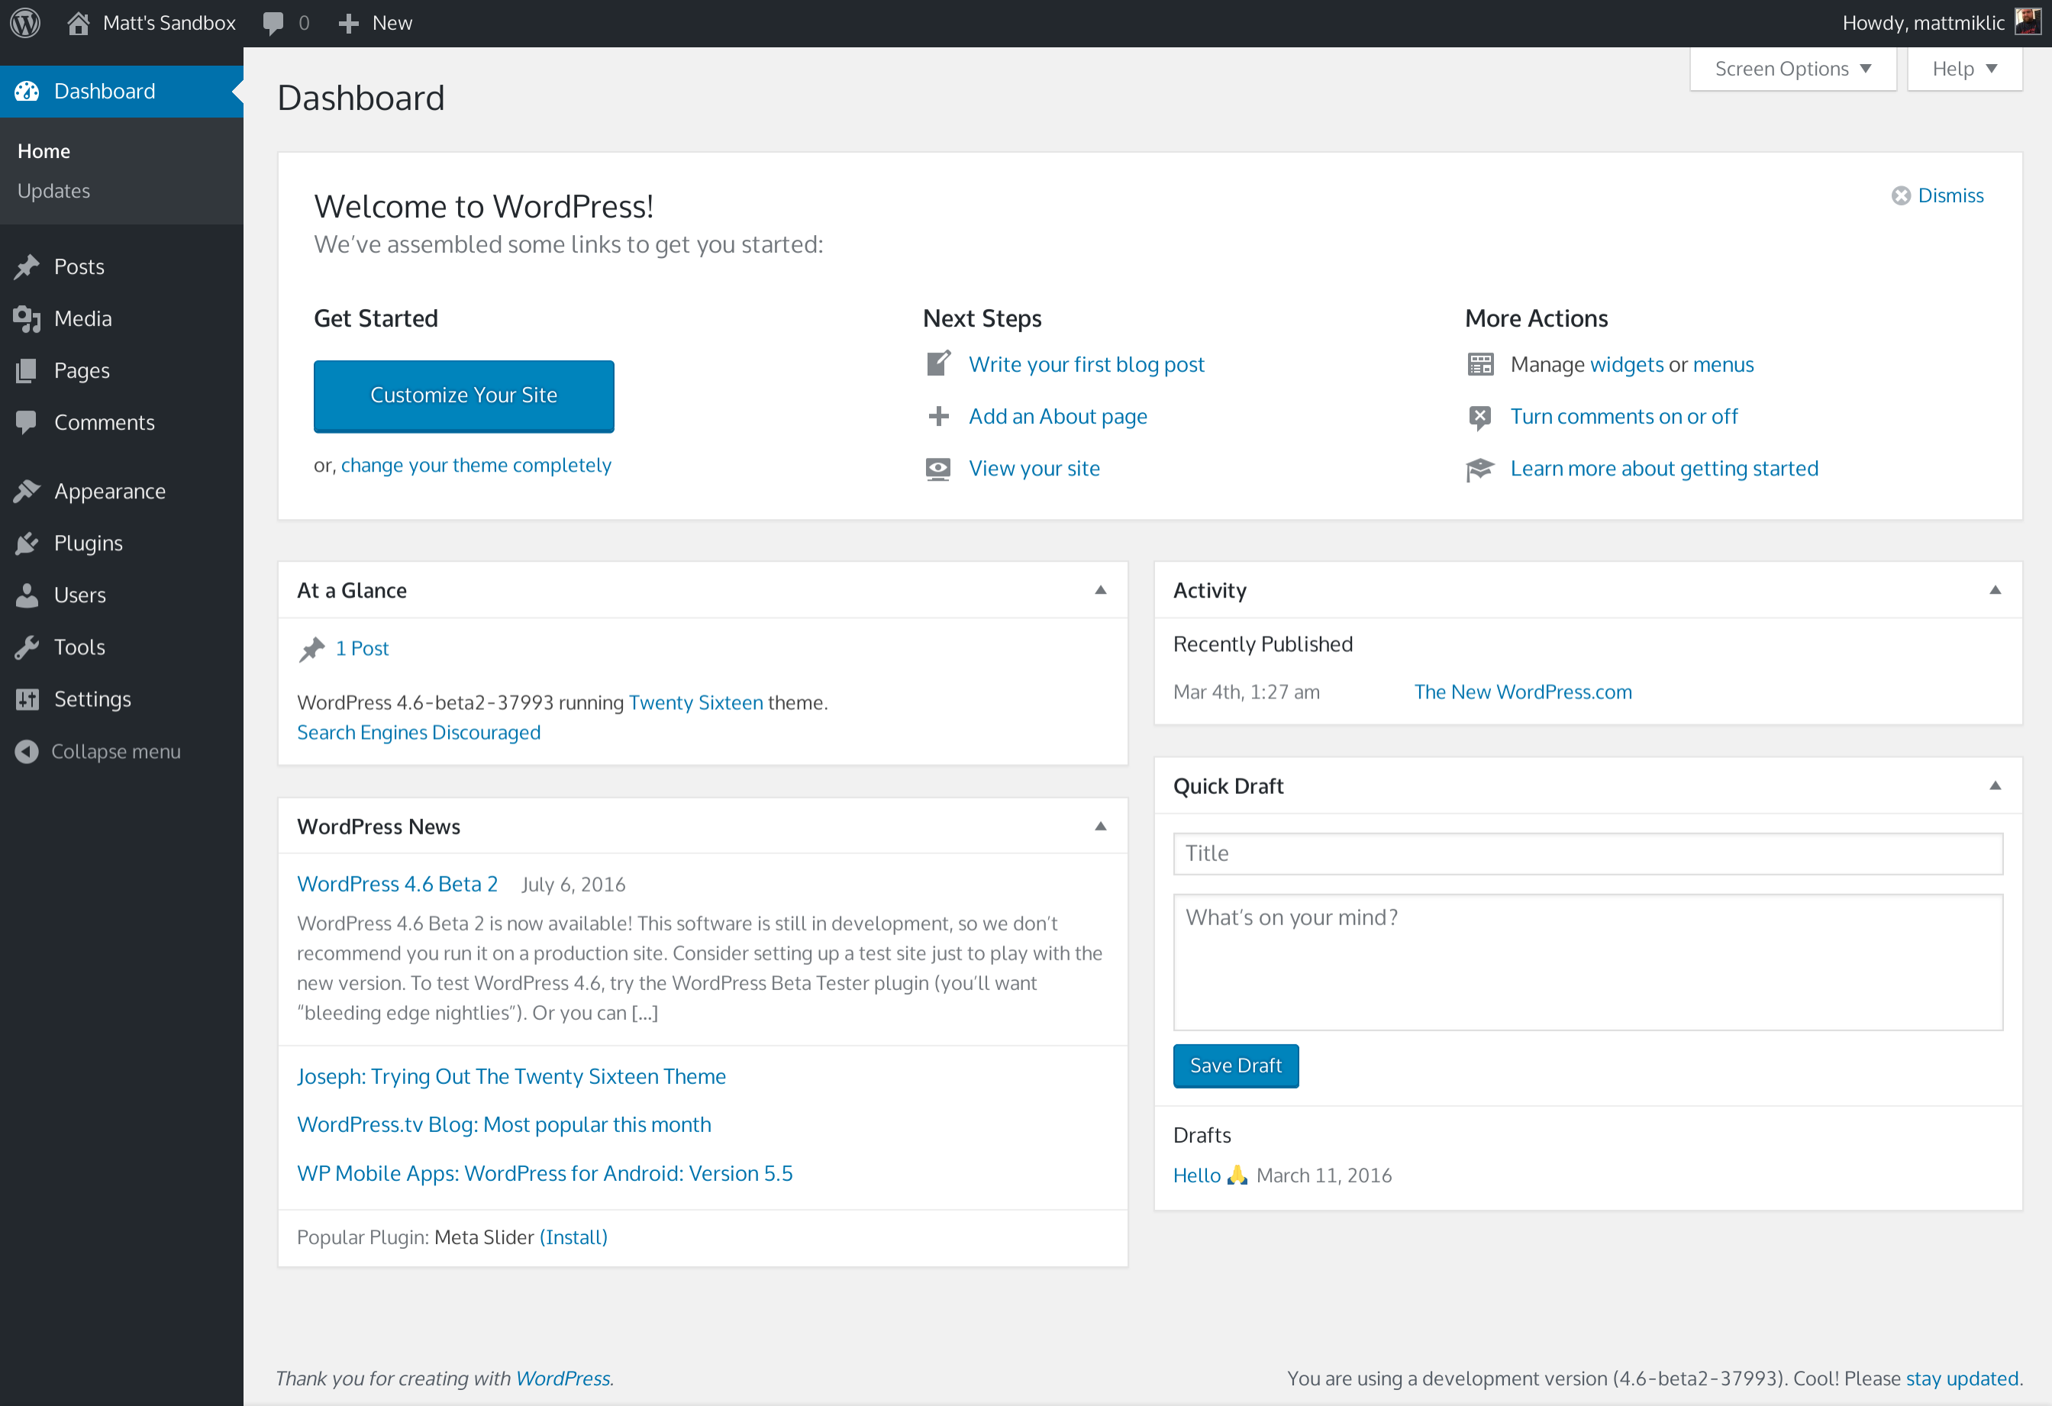
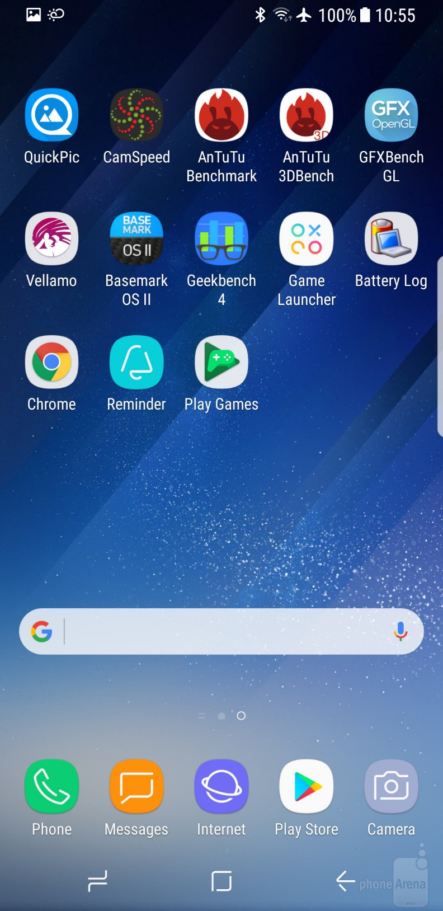
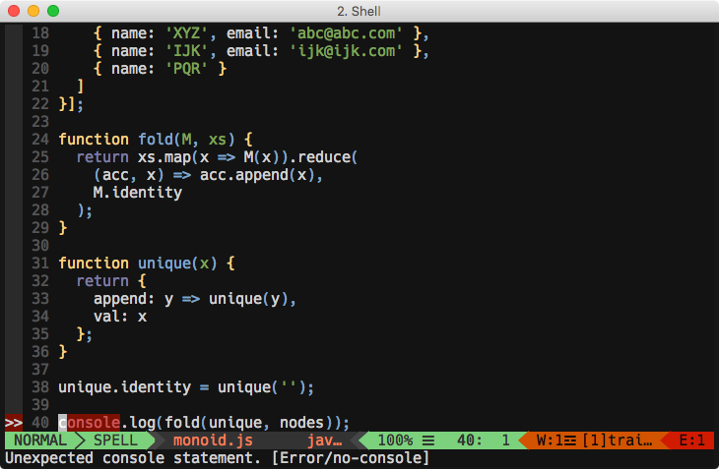
Notes:
Web browsers have historically allowed executables as plug-ins, though they are now mostly deprecated. (These are a different type of software module than browser extensions.) Two plug-in examples are the Adobe Flash Player for playing videos and a Java virtual machine for running applets.
A theme or skin is a preset package containing additional or changed graphical appearance details, achieved by the use of a graphical user interface (GUI) that can be applied to specific software and websites to suit the purpose, topic, or tastes of different users to customize the look and feel of a piece of computer software or an operating system front-end GUI (and window managers).
We are surrounded by software that is extended via:
- plugins
- apps
- applications
- programs
- whatever
Yet when we design for the web, we usually don't think in this way.
All the applications you use are plugins for your OS

Slide 17

A Plug-in based solution
Host application
Strict interface
Communication
Business Logic
View
Plug-ins
Packages
Version management
Notes:
Thus today I am going to present a solution to this problem. One that I am going to share together with all of it’s documentation at the end of this talk.
This outline shows some of the major things that need to be considered when we are creating a plugin-based system.
- Host application -> We need a host application/environment an ecosystem where our features are going to be plugged.
- Strict interface -> that is going to tell us what/how we must do to be compatible with our host.
- Communication -> There are multiple ways to achieve it. I am using a message bus in the reference implementation.
- Business Logic -> the core of our product
- View -> presentation of the features
- Plug-ins -> extensions
- Packages -> distribution
- Version management
I am not going to focus on the "host application". Any web app could be used as a base. I am also not going to focus on version management (although there is info about it in the github repo docs)
The focus of this talk is a feature developed as a plugin based system.
UML much? :)

Slide 18
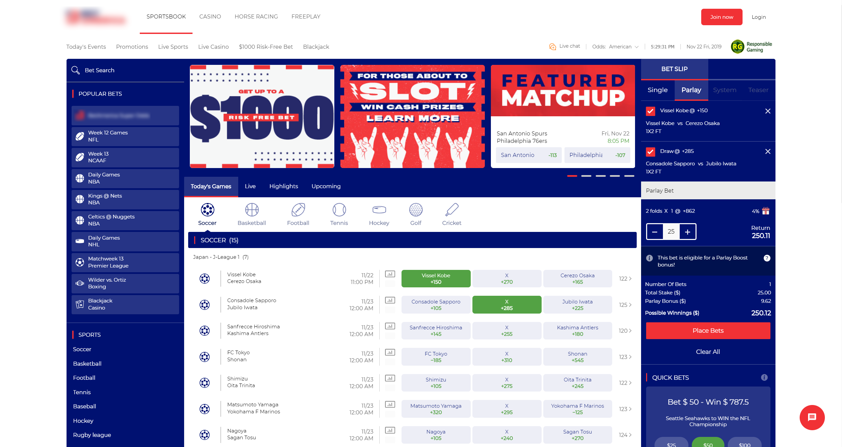
Notes:
What does a plugin-based solution mean for my web app?
Host application
Strict interface
Communication
Business Logic
View
Plug-ins
Packages
Version management

Slide 19
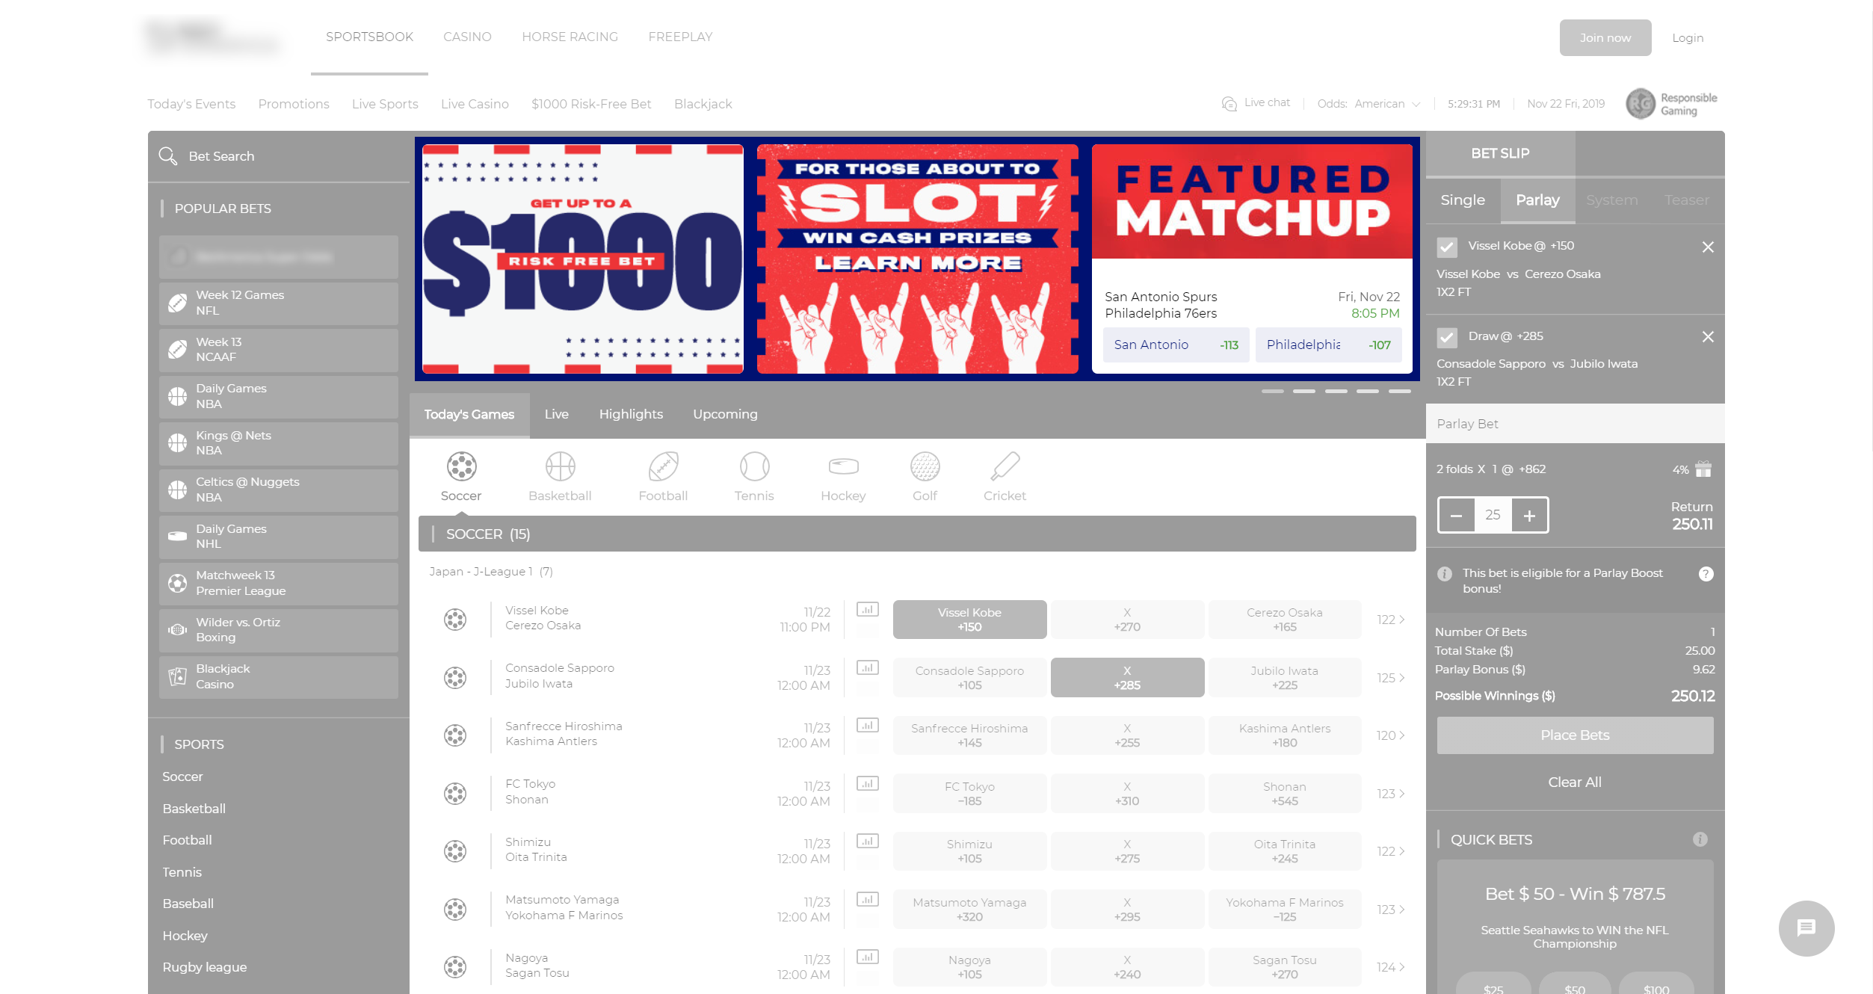
Notes:
Let’s take this piece of content as an example… and define the architecture while thinking of it…
The entire page is the host application, it takes care of bootstrap and routing between pages and so on…
This is some carousel type of thingy… it can communicate with other parts of the system, mainly adding prices to the shopping cart…
So we are going to have interface that allows us to communicate between each other
The view is the box where this carousel lives…
This carousel could be written in many frameworks … sometimes it is not going to be worth to re-write if we migrate to a new tech stack … why can’t we just re-use it?
You know what … let’s see some diagrams…

Slide 20
Interfaces - Msg Bus - Msg Channels - Component Status - IComponent - IBl - IPlugin - IPluginAPI
Notes:
Again let’s start with an interface…

Slide 21
VIEW
Interfaces - Msg Bus - Msg Channels - Component Status - IComponent - IBl - IPlugin - IPluginAPI
Notes:
This interface is going to be consumed by a view class

Slide 22
VIEW
Business Logic
Interfaces - Msg Bus - Msg Channels - Component Status - IComponent - IBl - IPlugin - IPluginAPI
Notes:
Business logic class

Slide 23
VIEW
Business Logic
Interfaces - Msg Bus - Msg Channels - Component Status - IComponent - IBl - IPlugin - IPluginAPI
Plug-in
Notes:
And of course the plugins
Talk about stability and organizing you components based on their stability
Moving BL packages between FE and BE

Slide 24
Third Party
VIEW
React
ReactDOM
Business Logic
Interfaces - Msg Bus - Msg Channels - Component Status - IComponent - IBl - IPlugin - IPluginAPI
MobX
Plug-in
Notes:
There are going to be some third-party dependencies of course…
Why React
Two main reasons:
1. Initial implementation for this concept was implemented in a company where React is the view library
1. This demo was written and documented for [http://react-not-a-conf.com/](http://react-not-a-conf.com/) 11.05.2019.
Additional reasons:
1. Functional approach
1. Good rendering performance
1. Good TypeScript integration
1. React is super cool :)
No, there are no React hooks in this demo, as they are not relevant to the architecture.
Why MobX
1. MobX is react agnostic. It doesn't care if you use it with React and TypeScript, making this a flexible solution. Very easy to create adapters for event driven implementations.
1. Very little amount of boiler plate code.
1. The redux pattern is just not suitable for this implementation.
1. Provides observable model with @decorators, making for super simple and readable implementations.
1. Internal state mutation provides improved performance for large scale applications dealing with a lot of real time changing data.

Slide 25
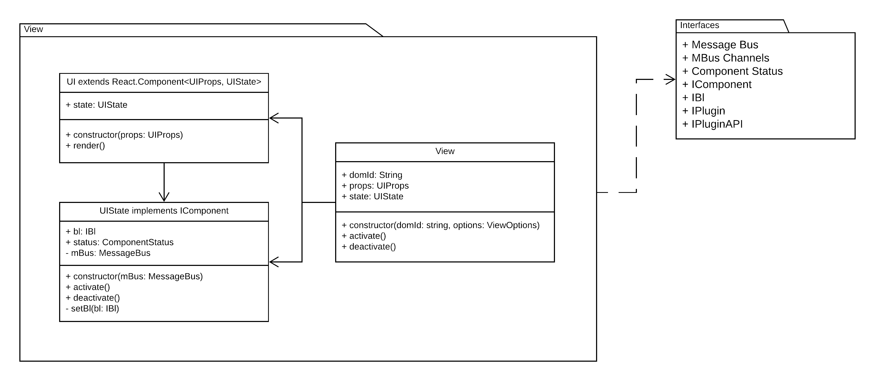
Notes:
A more detailed view just to give you highlight onto what I am going to show in terms of code.

Slide 26
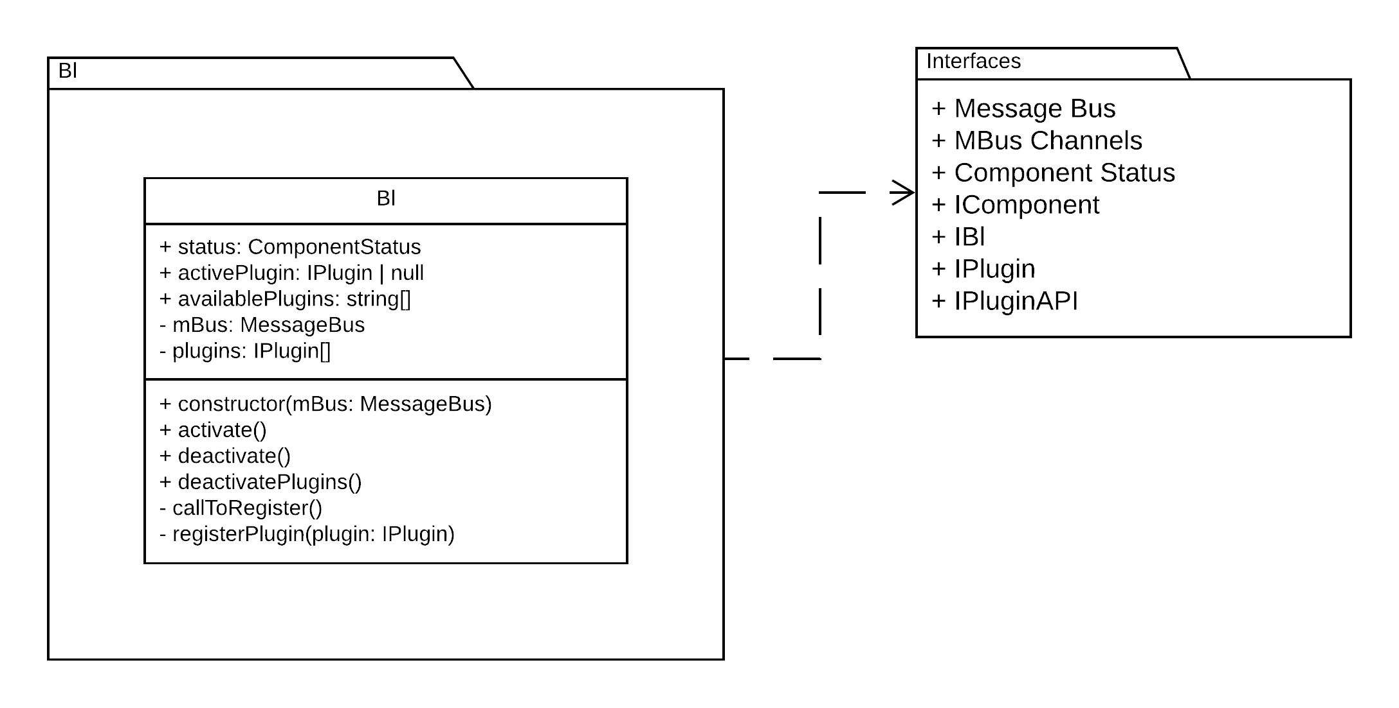

Slide 27
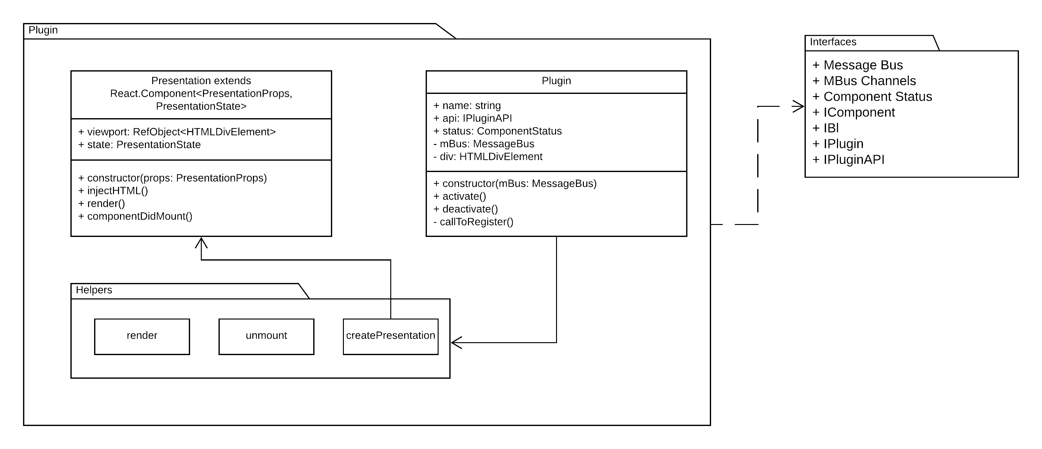

Slide 28
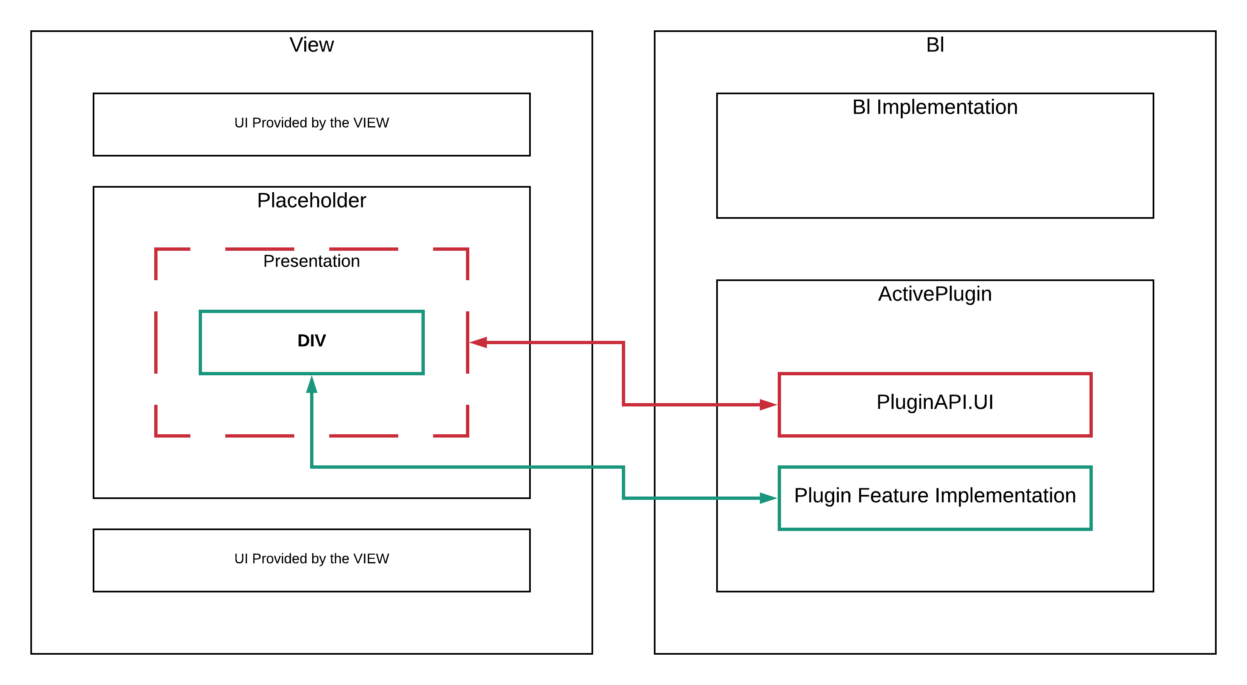

Slide 29

DEMO

Slide 30
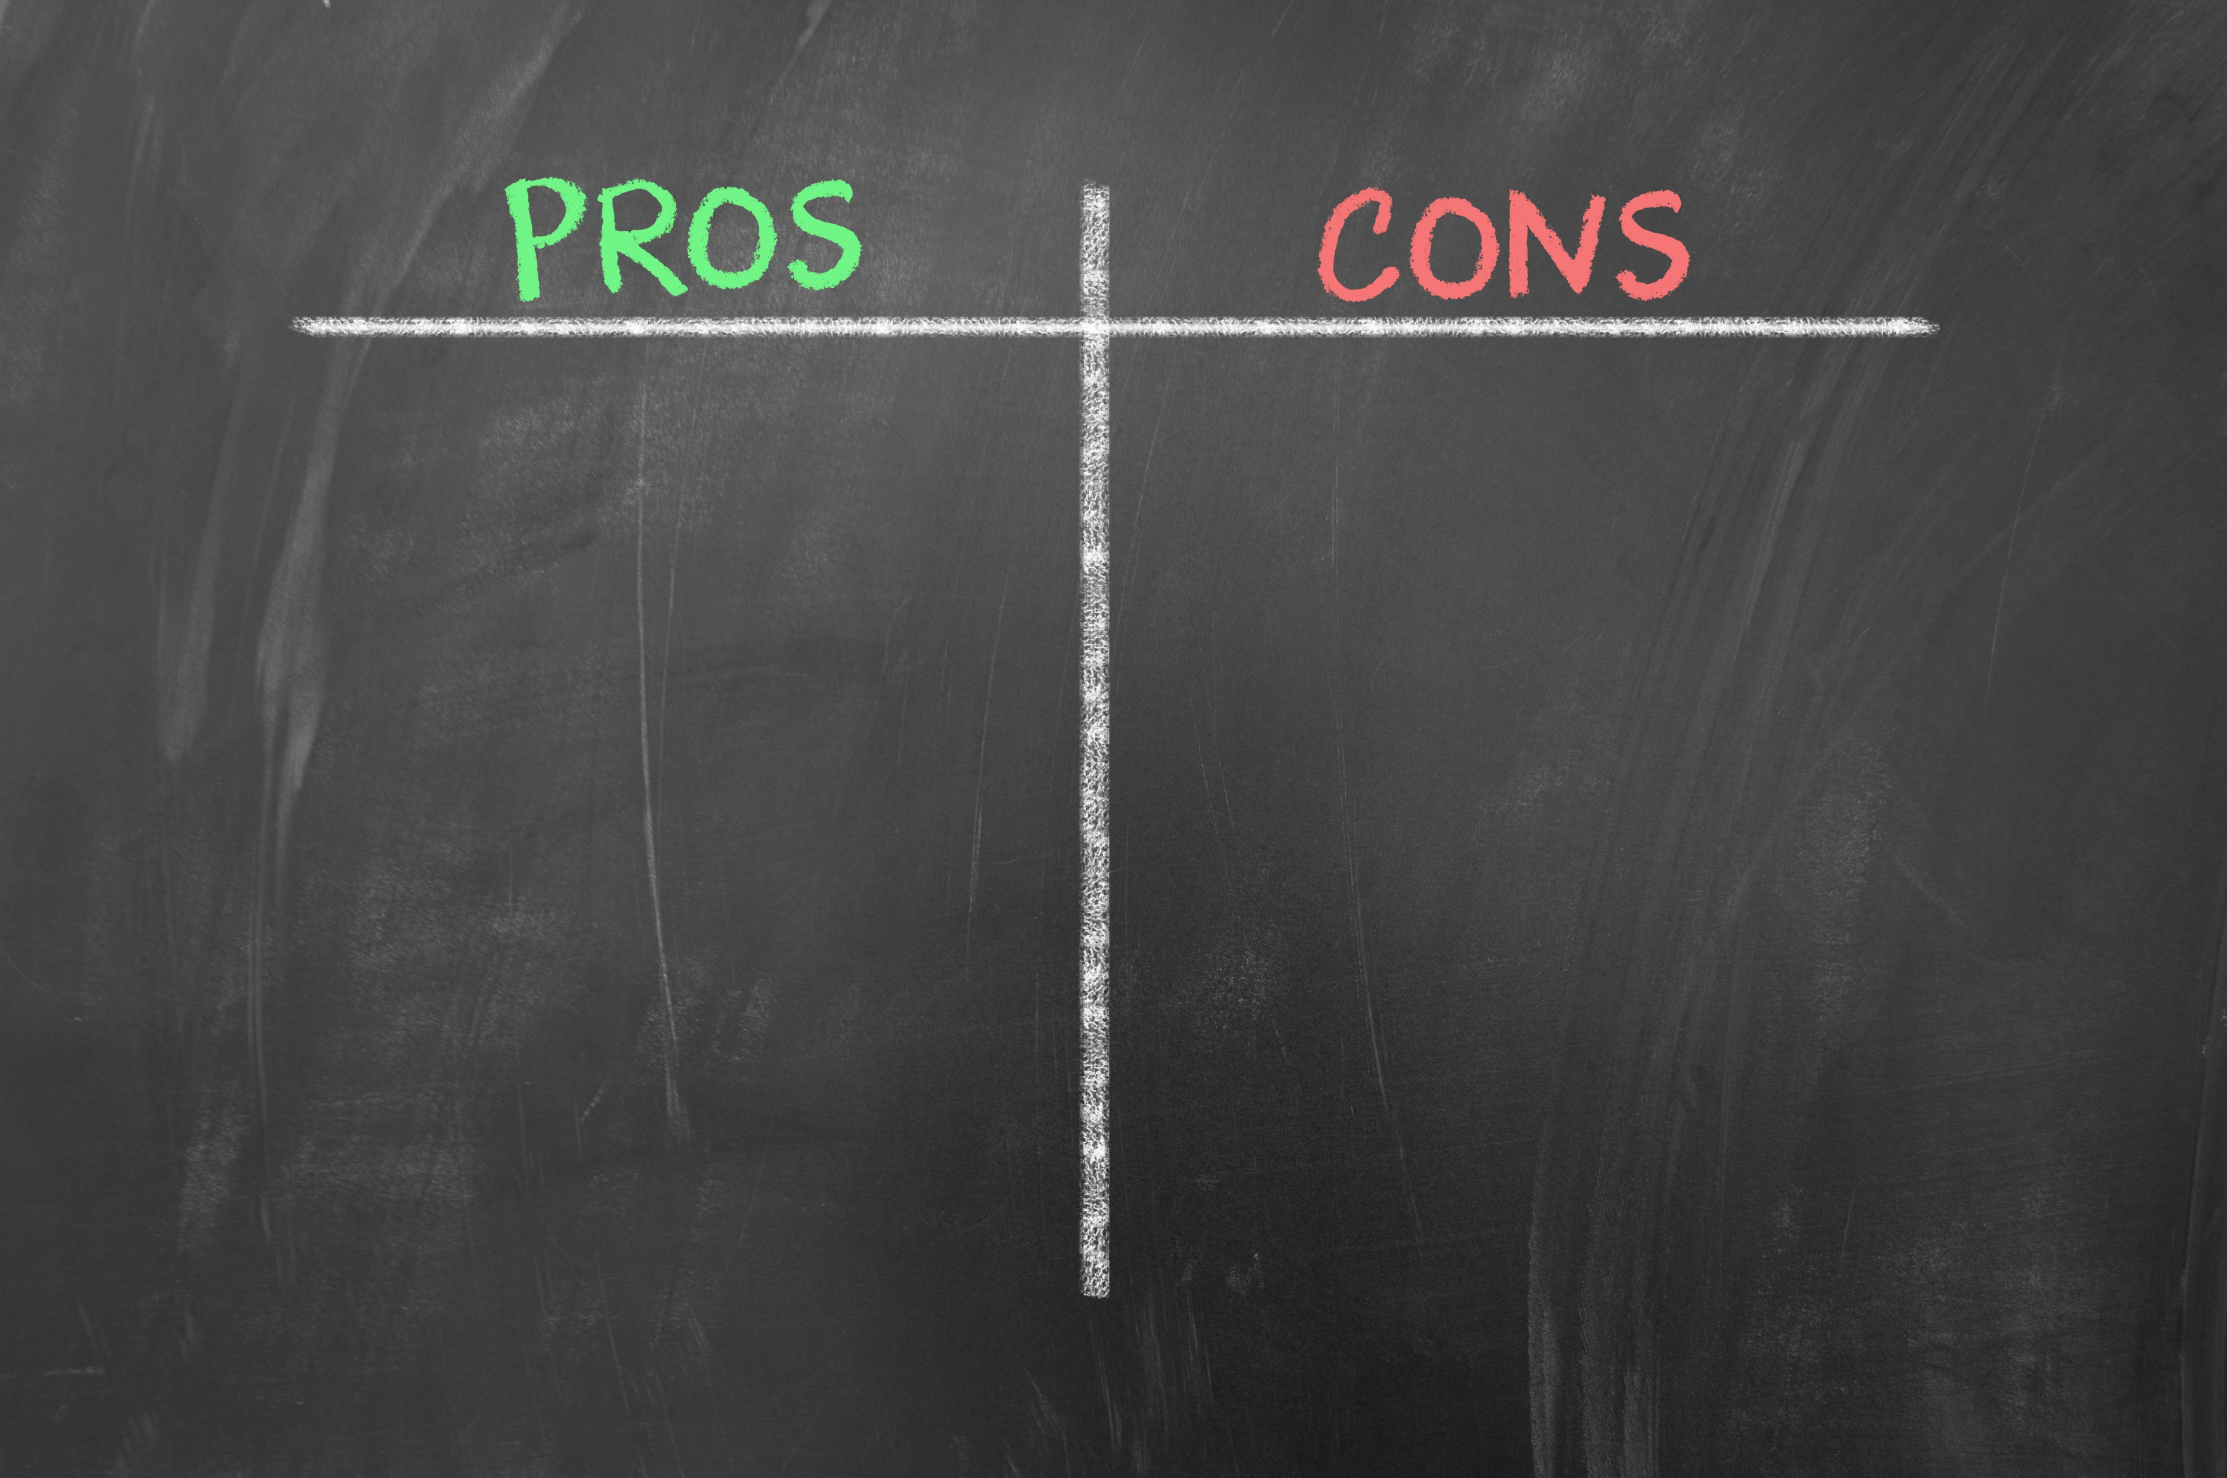
Independent development
Independent deployment
Independent release cycle*
Small bundles
Easy to test
Reduced regression scope
Technology agnostic*
Async loading of the packages
Easy deprecation
Coupled to a single interface package
Code duplication*
More experienced team
Coupled to a single interfaces package
Multiple packages to manage
Harder to organize
Harder to see the big picture
Notes:
Cons
- some code duplication is possible, but preferable to coupling between components
- more experienced team is needed to setup the foundation for this architecture
- every component is coupled to the same interfaces package. Breaking changes to the interfaces might lead to a massive update and redeploy of the components. Interfaces package must be stable, and this is not trivial to achieve. There are ways to mitigate this such as: introducing new interfaces into new more unstable packages.
- your offering is spread into many packages, sometimes it becomes harder to organize. Example: a customer's product is combination of views/bls/plugins with different versions.
Pros
- independent development
- independent deployability
- independent release cycle
- small easy to test bundles of code
- reduced regression scope
- technology agnosticism
- async loading of the packages
- easier to manage packages that are no longer used

Slide 31
Summary
Architecture
Plug-ins
Reference implementation
Pros/Cons

Slide 32


Slide 33

Connect ☺
LinkedIn: https://goo.gl/CRRJ2Y
Mail: martin@sbtech.com
Github: https://github.com/mchaov
@raziel_pld
Notes:
Present the second talk I am going to do

